Slide 1
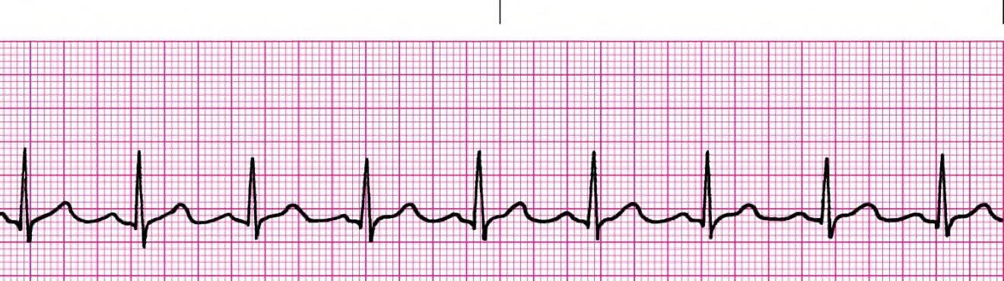
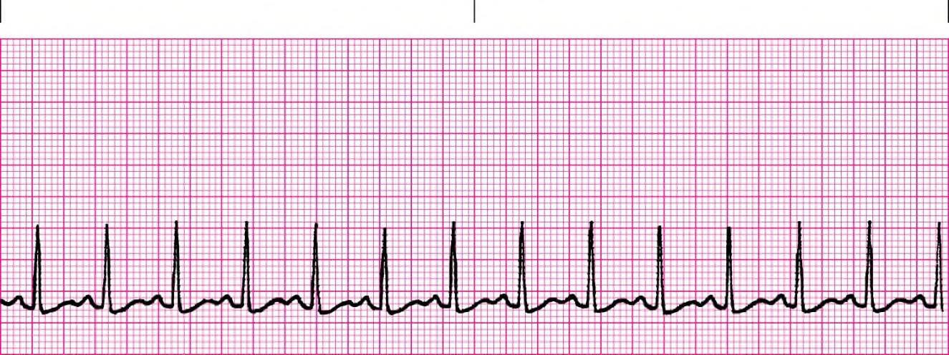
20 rhythm strips on precourse assessment with the following matching choices:
Agonal rhythm/asystole Atrial Fibrillation Atrial Flutter Ventricular Fibrillation Monomorphic Ventricular Tachycardia Normal Sinus Rhythm Polymorphic Ventricular Tachycardia | Pulseless Electrical Activity Supraventricular Tachycardia Second-degree atrioventricular block (Mobitz I, Wenckebach) Second-degree atrioventricular block (Mobitz II block) Sinus bradycardia Sinus tachycardia Third-degree atrioventricular block
RHYTHM & ♥ ETIOLOGY | CRITERIA OVERVIEW | UNIQUE CRITERIA | SAMPLE STRIPS
***Normal Sinus Rhythm ♥ Normal, None | RHY – Regular R – 60-100 P – Upright PRI – 0.12 – 0.20 QRS – 0.04 – 0.10 | None, normal rhythm
***Sinus Tachycardia ♥ Exercise ♥ Anxiety ♥ Caffeine ♥ Nicotine ♥ Fever ♥ Shock ♥ CHF ♥ Hypotension ♥ Pain ♥ Hypoxemia ♥ Anterior MI | RHY – Regular R – 100 - 150 P – Upright PRI – 0.12 – 0.20 QRS – 0.04 – 0.10 | Rate 100 - 150

Slide 2
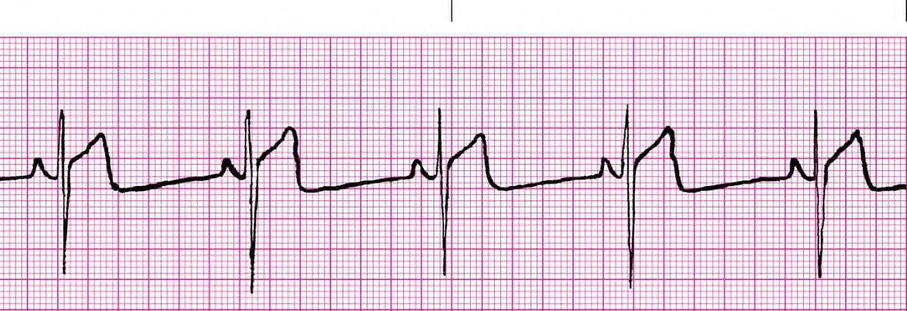
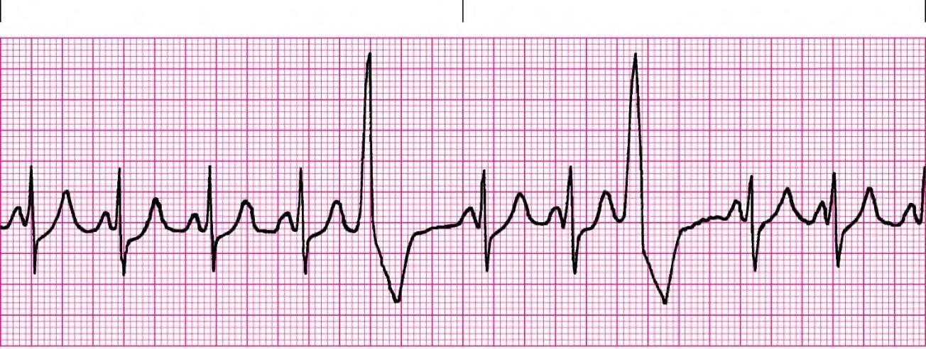
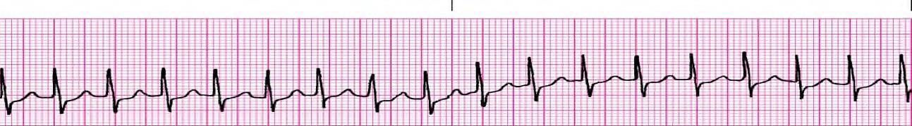
RHYTHM & ♥ ETIOLOGY | CRITERIA OVERVIEW | UNIQUE CRITERIA | SAMPLE STRIPS
***Sinus Bradycardia ♥ Damage SA ♥ Normal sleep athletes ♥ Vagal ♥ Glaucoma ♥ Hypothermia ♥ Inferior MI ♥ Drugs – MS, digoxin, Inderal ♥ IICP | RHY – Regular R – below 60 P – Upright PRI – 0.12 – 0.20 QRS – 0.04 – 0.10 | Rate below 60 (AHA below 50)
***PVC/PVD Premature Ventricular Contraction/Depolarizati on ♥ Hypoxia, ♥ Hypotension ♥ anemia ♥ Ischemic hrt dis ♥ Electrolytes ♥ M.I. ♥ Myocarditis, pericarditis ♥ CHF ♥ Stress, fatigue, smoking, overeating, caffeine ♥ Hypoglycemia ♥ Sepsis ♥ Cyclic anti- depressants ♥ Acidosis | AN ECTOPIC BEAT RHY – Irregular R – 60-100 P – Upright PRI – 0.12 – 0.20 QRS– 0.04 – 0.10 | SR, early beat has VENT beat (wide & bizarre)
Supraventricular Tachycardia ♥ Not visible sudden start or stop. | RHY – Regular R – 160 - 250 P – Upright PRI – 0.12 – 0.20 QRS– 0.04 – 0.10 | Rate above 150 - 250

Slide 3
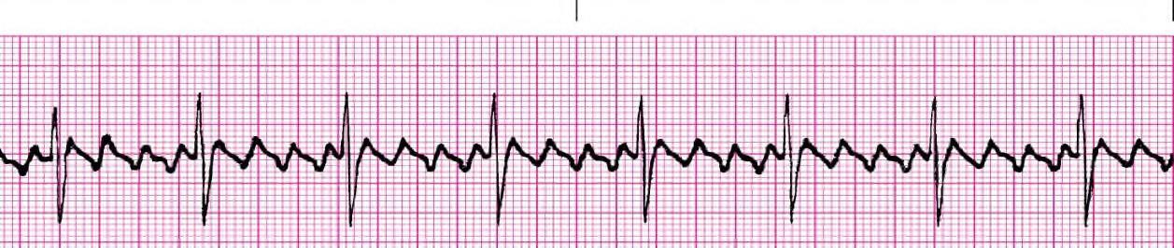
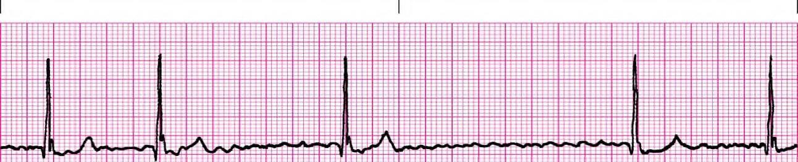
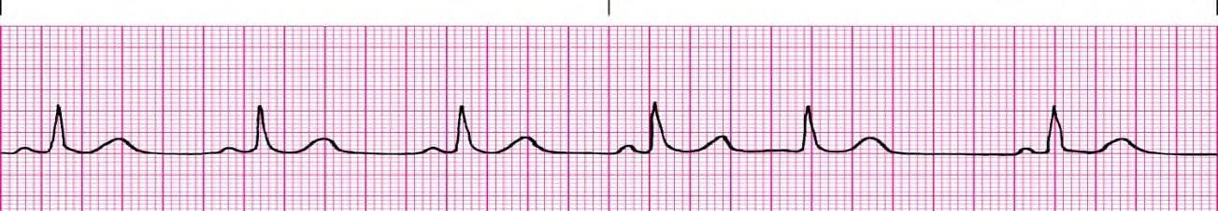
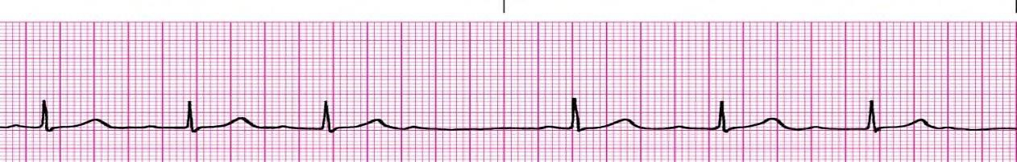
RHYTHM & ♥ ETIOLOGY | CRITERIA OVERVIEW | UNIQUE CRITERIA | SAMPLE STRIPS
***Atrial Flutter ♥ Ischemic heart disease ♥ MI ♥ Dig toxicity ♥ Mitral, Tricuspid valve disease ♥ Stress ♥ PE ♥ Hyperthyroid ♥ Often temp | RHY – Regular or Irregular R– Atrial 250–400 Vent: 70 - 150 P – none, F’s PRI – none QRS – 0.04 – 0.10 | Regular or Irregular, no P’s (called F’s) Saw tooth
Atrial Fibrillation ♥ Ischemic heart disease ♥ Dig toxicity ♥ CHF ♥ MI ♥ Mitral or Tricuspid valve disease | RHY – Irregular R– atrial 350-600 Vent. – below 100 controlled, above 100 uncontrolled. P – None f’s PRI – none QRS – 0.04– 0.10 | Irregular, no P’s (called f’s)
***PEA Pulseless Electrical Activity ♥ Looks like any rhythm that should have a pulse but does not
***2nd degree AV Block Type I – Mobitz I, Wenckeback | RHY – Irregular PRI – vary QRS– 0.04 – 0.10 | Irregular EXTRA Ps PRI longer & longer, Dropped QRS

Slide 4
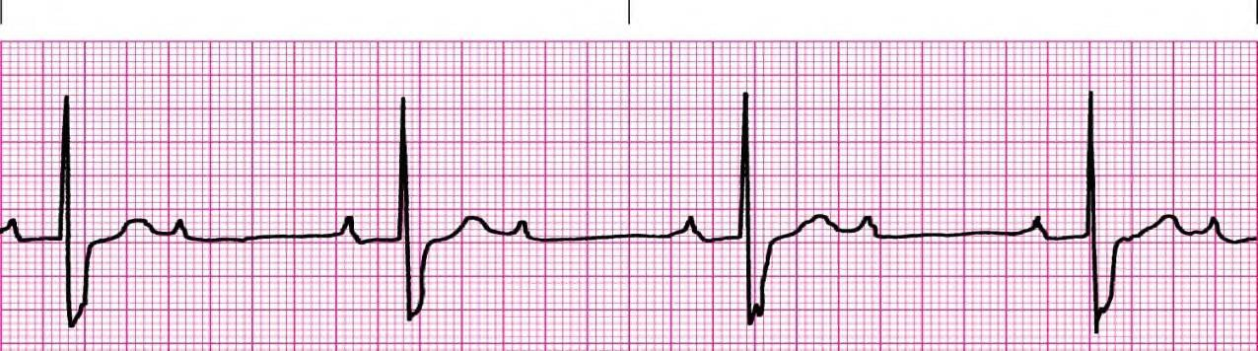
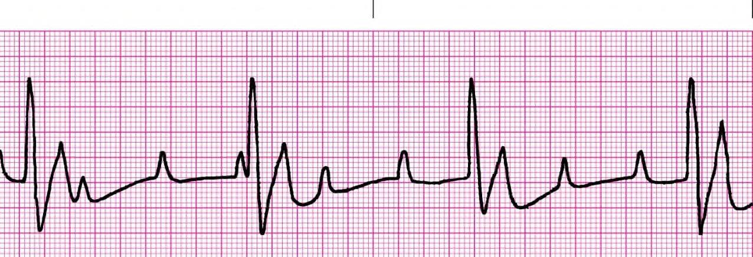
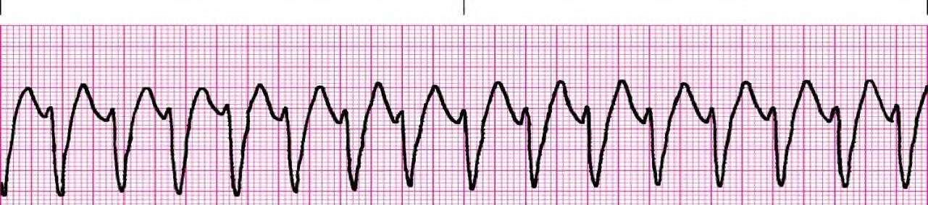
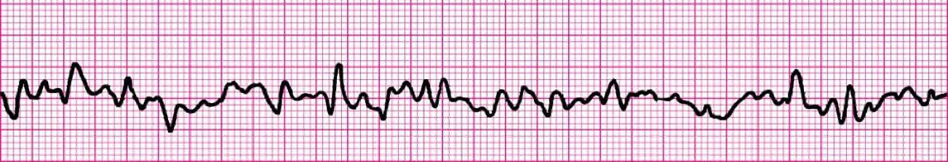
RHYTHM & ♥ ETIOLOGY | CRITERIA OVERVIEW | UNIQUE CRITERIA | SAMPLE STRIPS
***2nd degree AV Block Type II or Mobitz II | RHY – Regular or Irregular PRI – constant QRS – normal or wide | Regular or Irregular EXTRA Ps
3rd degree AV | RHY - Regular | Regular
Block, Complete | PRI – vary | EXTRA Ps
Heart Block | QRS – usually | PRI varies
♥ Same as 1st degree | wide | greatly
***Ventricular Tachycardia monomorpic ♥ All complexes are the same shape and look the same ♥ Wide complex tachycardia | RHY – Regular R – Above 100 P – None PRI –None QRS – Wide, Bizarre | R over 100 All Vent beats
***Ventricular Fibrillation ♥ Following V Tach ♥ Acute MI ♥ Electrolyte Imbalance | RHY – Chaotic R – None P – None PRI –None QRS – none, fibrillatory line | Chaotic wavy line. No pulse.

Slide 5
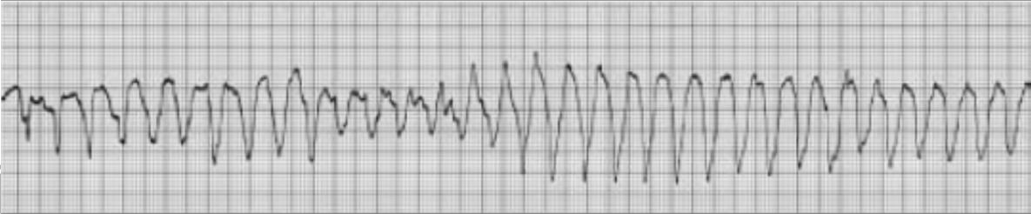
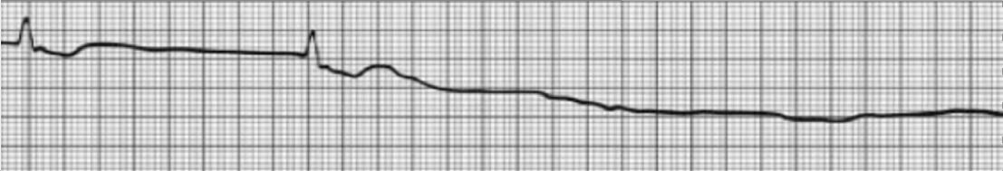
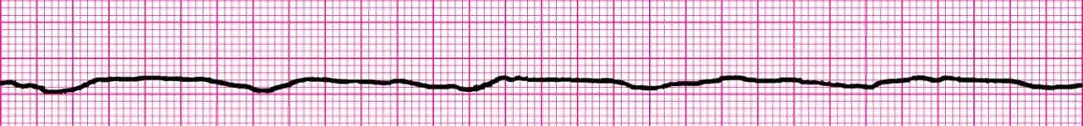
RHYTHM & ♥ ETIOLOGY | CRITERIA OVERVIEW | UNIQUE CRITERIA | SAMPLE STRIPS
Torasades de Pointes Polymorphic ventricular tachycardia Best Treated with magnesium | RHY – Chaotic waves R – None P – None PRI –None QRS – points twist | Chaotic wavy line. No pulse. Points twist
***Agonal ♥ Dying heart ♥ Drugs used in cardiac arrest provide some electrical waves. | RHY – Regular R – Slow P – None PRI – None QRS – very very wide | Slow wide bizarre stretched out waves. No Pulse
***Asystole ♥ Primary event in cardiac arrest. ♥ Untreated V-tach or V-fib | RHY – None unless only Ps R – No Vent rate P – may be present PRI – None QRS – None | Straight line or only Ps No Pulse

Slide 6
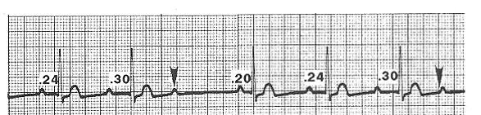
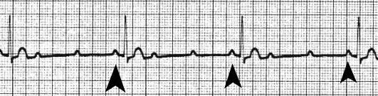
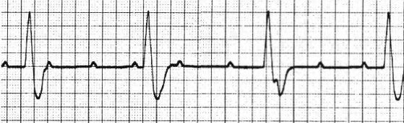
Heart Blocks and Tricks for Analysis
 |  |  | 2nd degree AV block Type I Mobitz I Wenckeback Rhythm is always irregular from QRS to QRS PR intervals get longer and longer
 |  |  | 2nd degree AV block Type II Mobitz II PR intervals on conducted beats are the same - the only heart block with extra P's that has this.
 |  |  | 3rd Degree Heart Block Complete Heart Block Rhythm is always regular from QRS to QRS PR Intervals different.

Slide 7
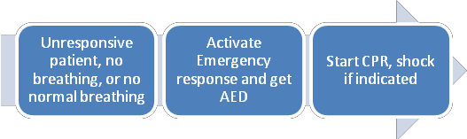
ACLS Helpful Hints 2015 Guidelines
Also see www.heart.org/eccstudent: The code is found in the ACLS Provider manual page ii.
The ACLS exam is 50 questions. Passing score is 84% or you may miss 8 questions. For those persons taking ACLS for the first time or renewing with a current card, exam remediation is permitted should you miss more than 8 questions on the exam. Viewing the ACLS book ahead of time with the online resources is very helpful. The American Heart Association link is www.heart.org/eccstudent and has a pre-course self-assessment, supplementary written materials and videos.
The code for these online resources is in the ACLS Provider manual page ii. The code is ACLS15. Basic Dysrhythmia knowledge is required. The exam has at least 9 strips to interpret.
*Cardiac Rhythm Strips to Interpret
BLS Overview - CAB ✓ Ventricular Tachycardia
Stable
Unstable
Monomorphic
Supraventricular tachycardia, unstable
Heart Blocks
Push Hard and Fast-Repeat every 2 minutes
*If person unresponsive next step is to check breathing and pulse. Pulse check no more than 5-10 seconds. Anytime there is no pulse or unsure - COMPRESSIONS
o Second-degree atrioventricular Type I o Second-degree atrioventricular Type II o Third degree atrioventricular
Ventricular Fibrillation
PEA, Pulseless Electrical Activity
Elements of good CPR
Compressions
Bradycardia
Rate-at least 100 - 120
Compression depth at least 2 inches, not more than 2.4 inches or 6 cm
Switch compressors every 2 min or 5 cycles
Recoil
Minimize interruptions (less 10 secs)
Need to assess stable versus unstable. If stable, monitor, observe, and obtain expert consultation. If unstable…
•Atropine 0.5mg IV. Can repeat Q 3-5 minutes to 3 mg Maximum dose is 3mg (Including heart blocks)
If Atropine ineffective
-Dopamine infusion (2-10mcg/kg/min)
-Epinephrine infusion (2-10mcg/min)
-Transcutaneous pacing
*Ventilation
With perfusing rhythm squeeze the bag once every 5 to 6 seconds
Excessive ventilation decreases cardiac output
Tachycardia with a pulse
Fatal mistake to interrupt compressions – can compress while charging.
•If unstable (wide or narrow)-go straight to synchronized cardioversion
•If stable narrow complex
-obtain 12 lead
-vagal maneuvers
*-adenosine 6mg RAPID IVP, followed by 12mg
Stroke
Cincinnati Pre-Hospital Stroke Scale
Facial Droop, Arm Drift, Abnormal Speech
*Non-contrast CT scan of the head
*Start fibrinolytic therapy as soon as possible
*Alerting the hospital will expedite patient’s care on arrival.
Pulseless Rhythms - Cardiac Arrest - CPR
Acute Coronary Syndromes, STEMI
*STEMI door-to-balloon within 90 minutes
*12 Lead for CP, epigastric pain, or rhythm change Recommended dose of aspirin is 160 – 325 mg Right ventricular MI - caution with NTG
Oxygen, monitor, IV, Fluids, Glucose Check
*Agonal gasps are a likely indicator
♥ 2 minute cycles of compressions, shocks (if VF/VT), and rhythm checks.
♥ *Epinephrine 1 mg first every 3-5 minutes (preferred method peripheral IV)

Slide 8
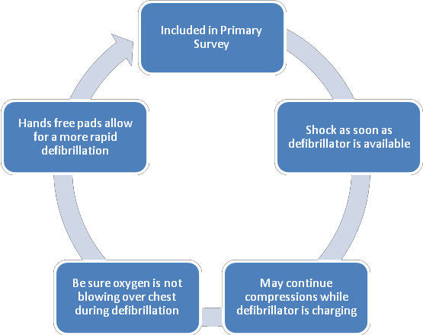
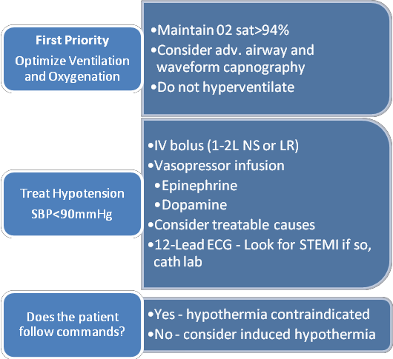
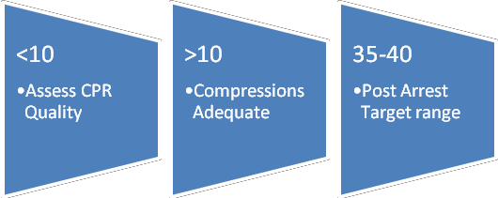
Shockable rhythms
*Defibrillation
-Ventricular Fibrillation (VF)
-Ventricular Tachycardia (VT) without pulse Biphasic: 120-200J Monophasic: 360J
*Refractory – Amiodarone 300 mg, then 150 mg
*After defibrillation resume CPR, starting with chest compressions
T r eat r ev ers i bl e c aus es ( H’s and T ’s ) Hypoxia or ventilation problems Hypovolemia
Hypothermia
Hypo /hyper kalemia
Hydrogen ion (acidosis)
*Synchronized Cardioversion
Unstable VT, unstable SVT
Tamponade, cardiac Tension pneumothorax Toxins – poisons, drugs
Thrombosis – coronary (AMI) – pulmonary (PE)
Non-Shockable Rhythms
-PEA (Push/Epi/Analyze H+T)
-Asystole
Return of Spontaneous Circulation (ROSC) Post Resuscitation Care
12 Lead
*Coronary reperfusion-capable center is the most appropriate EMS destination.
*Hypothermia if DOES NOT follow verbal commands (target temperature, at least 24 hours, 32 to 36 degrees C)
*Waveform Capnography in ACLS (PETC02)
Allows for accurate monitoring of CPR
*Most method to confirm and monitor ETT placement
Points to Ponder
*Medical Emergency Teams (MET)/ Rapid Response Teams (RRT) can improve outcome by identifying and treating early clinical deterioration.
*OPA – measure from corner of mouth to angle of the mandible
*Minimal systolic blood pressure is 90
Don’t suction for more than 10 seconds
*Pulse oximeter reading low, give oxygen
*Team Dynamics
Closed Loop – repeat orders
Incorrect order? – address immediately
Task out of scope? – ask for new task or role
Clearly delegate tasks

Slide 10
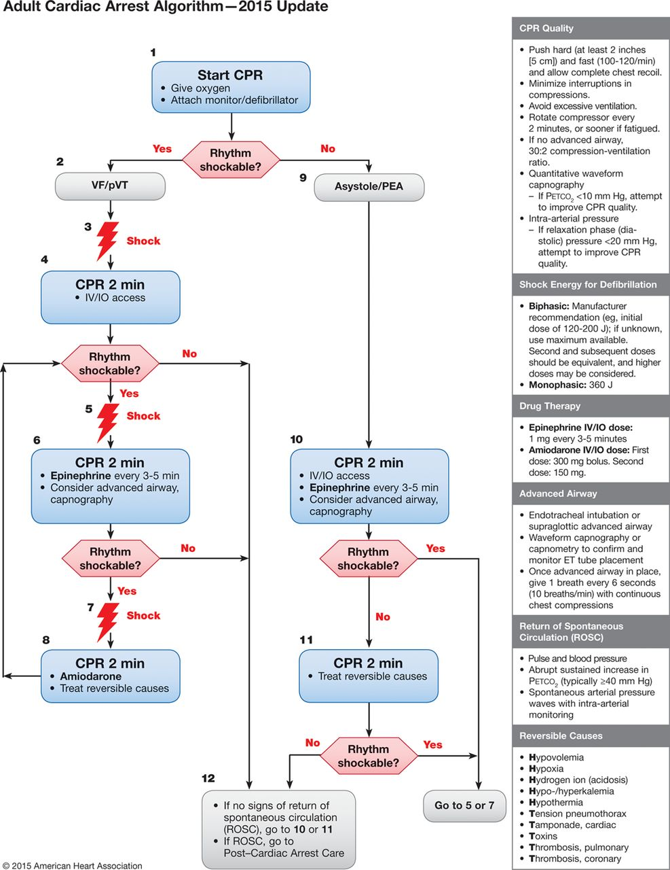

Adult Cardiac Arrest Algorithm―2015 Update.
Mark S. Link et al. Circulation. 2015;132:S444-S464
Copyright © American Heart Association, Inc. All rights reserved.
Notes:
Adult Cardiac Arrest Algorithm―2015 Update.

